Slide 1

Monitoring a MICROSERVICES
web application using Prometheus and Grafana
Jordi Ruiz
Fullstack Developer, Mercuria Energy S.A.
Notes:
Hello everyone and welcome to this talk: “Monitoring a MICROSERVICES web application using Prometheus and Grafana”. As you can see the word MICROSERVICES is highlighted but at the same time is completely redundant. I could have name this talk Monitoring a web application using Prometheus and Grafana and still makes sense. But it is not the same, I am sure that instead of having a room full of people I would have had 4 o 5 people, most of them the guys that work with me, maybe Pau the organizer and someone else that came for the beers. Let’s be honest, people have better things to do, I don’t know maybe install the latest JavaScript Framework or refresh Twitter every 5 seconds. But because I have added the word MICROSERVICES, that change the game. You feel that you cannot miss this talk or you are out of the wave. Although, you can come here and just download the lastest Javascript Framework and refresh Twitter every 5 seconds.

Slide 2

BIO
Jordi Ruiz Jiménez
FULLSTACK developer
https://www.linkedin.com/in/jordiruizj/
https://twitter.com/jruizx
https://github.com/jruizx
Notes:
Who am I? My name is Jordi Ruiz and I am FULLSTACK developer based in London. Again, I have highlighted Fullstack in bold and uppercase, and exactly for the same reason, because is trending, nothing else. I could have said that I am a developer, but it sounds a bit like I am loser. You put on your linkedin that you are developer and no one contact you. On the other hand, you put that you are a fullstack developer and I can guarantee you that every couple of days you receive a message from a recruiter. Which they are quite annoying… However I quite like to see notifications on my phone. It looks like I have some friends and a exciting social life. Jokes apart, I think you title is very important, but I have to give you a bad news. It doesn’t matter how hard you work, or how important is the job you are doing, the best title ever has already been assigned.

Slide 3


Slide 4

WHERE DO I WORK?
Notes:
So as I said I am a fullstack developer, basically I do C# using the new dotnet core framework and javascipt using the Angular framework and I do my work on this company called Mercuria. Mercuria is a energy and commodity trading company based in Geneva, Switzerland. Our team is quite distributed around the world. I am working in London, there are people working in Geneva, there are people working in Barcelona, one working in France, another in Singapur and we even have one guy working in the most remote place that you can imagine, Dos Hermanas, Seville… So it is quite challenging working remotely but so far so good. By the way we are hiring!!! So if any of you guys are looking for new challenges please let us know, or send us a CV.

Slide 5
WHERE DO I WORK?
WE ARE HIRING

Slide 6

THE PROJECT
Notes:
A year ago, more or less, we started a project to put some governance to all the back office processes in Mercuria, everything except the trading business: Recruiting, Hiring, Legal processes, accounting, IT, Taxes, subscriptions, and so on. I would describe this as a ginormous project. From the beginning we knew that we were going to deal with a complex Domain for our solution. So we decided to apply Domain Driven Design in order to tackle the complexity.

Slide 7





THE PROJECT
Notes:
We had read a few books about Domain Driven Design, Microservices and good development practices like TDD or eXtreme Programming. So we felt a bit like Don Quixote, crazy enough to start our project and kill the giants. So we started defining some aggregates, entities, repositories, services, etc. inside of a bounded context that eventually would be deployed as an isolated micro service.

Slide 8

WORKING H ARD
Notes:
So, we worked really hard and in a few months we had our business experts defining functionality using amazing wireframes, our developers had built a nice Continuous Integration system on top of Gitlab, with a nice pipeline that build our solution, execute some tests, and deployed everything inside of Docker containers. So testers, domain experts, and stakeholders could navigate to our application built with angular and dotnet core and start giving us priceless feedback. They were happy days, but suddenly…

Slide 9

Notes:
We received a phone call from our Project Director, let’s call him Mr. S.
Hello guys, I have done a few demos to some departments and they love the solution that we are building.
Yeah that’s amazing!
So we have to start planning the production environment and open it to people.
What?!!??

Slide 10

Notes:
So we were panicking for a while, but our technical lead, let’s called him Mr. D. came with a few motivational sentences from I guess Paulo Coelho or some kind of cheap business school. The typical this is not a problem this is an opportunity to shine. This is what we have been waiting, etc. So we arrange a technical meeting and decided what we need to put our solution in production. During this meeting someone suggested that we needed some kind of monitoring system to check the health of our solution. In this kind of meeting you feel like you have to say something and because I was quiet during the meeting suddenly my brain had some kind of shortcut and I said OK, I can do that. Even though I never had implemented any kind of monitoring system. So after the meeting I did what any decent person would have done.

Slide 11

Notes:
Hold on a second, I think this is the second thing I did. The first thing I did was to look for what the hell monitoring means…

Slide 12
MONITORING
monitoring
​present participle of monitor
monitor verb [ T ]
UK ​ /ˈmɒn.ɪ.tə^{r}/ US ​ /ˈmɑː.nə.t̬ɚ/
​to watch and check a situation carefully for a period of time in order to discover something about it:
The new findings suggest that women ought to monitor their cholesterol levels.
The CIA were monitoring his phone calls.
Notes:
I came with the Cambridge Dictionary definition. “To watch and check a situation carefully for a period of time in order to discover something about it”. This definition is so interesting and it is what we wanted to do. Check our system for a period of time to check if it was behaving properly. Anyway, after a few searches in google and reading a bit in Stackoverflow, I don’t think I went to the second page in Google, I discovered an open source solution that is being adopted for many companies and organizations in our industry. I would like to welcome Prometheus!

Slide 13

PROMETHEUS
Notes:
Prometheus is a monitoring system. It collects metrics from configured targets at given intervals, evaluates rule expressions, display the results, and can trigger alerts if some condition is observed to be true.

Slide 14
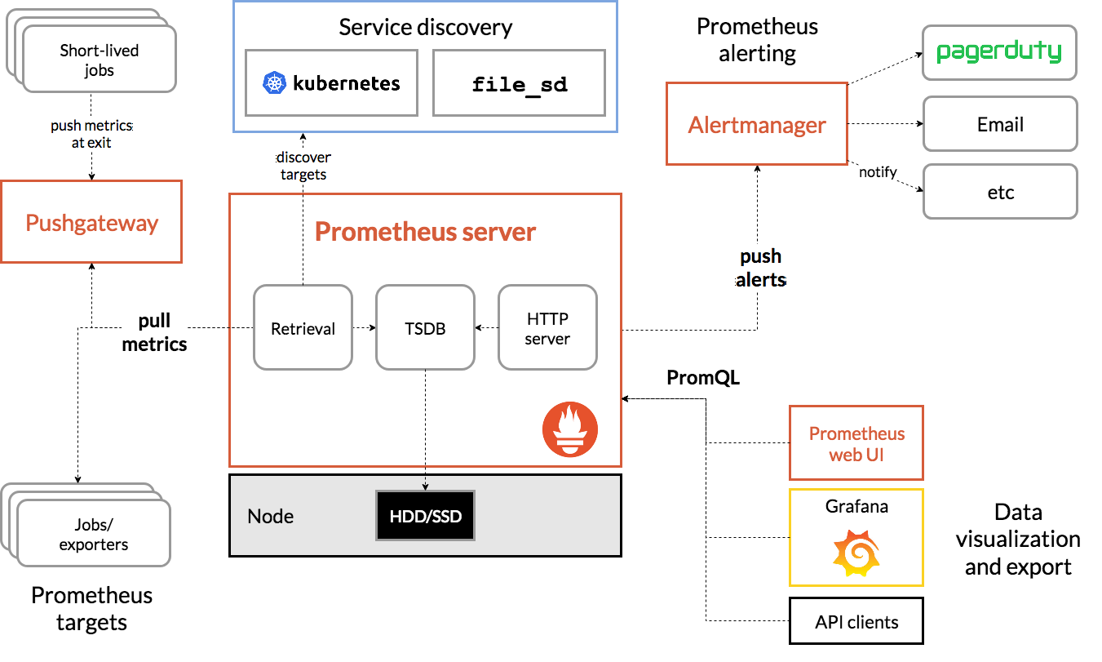
PROMETHEUS ARCHITECTURE
Notes:
Prometheus collect metrics from job exporters, either directly o via a intermediary push gateway, I have never used this pushgateway, so please don’t ask any questions about it. It store all this data that collects locally and runs rules over this data to aggregate or generate alerts. We can use Prometheus web UI to visualize this data or we can use data visualization tools like grafana. Let’s give a nice welcome to Grafana, Prometheus best friend.

Slide 15

GRAFANA
Notes:
Grafana is an open source, feature rich metrics dashboard and graph editor for Graphite, Elasticsearch, OpenTSDB, Prometheus and InfluxDB.

Slide 16
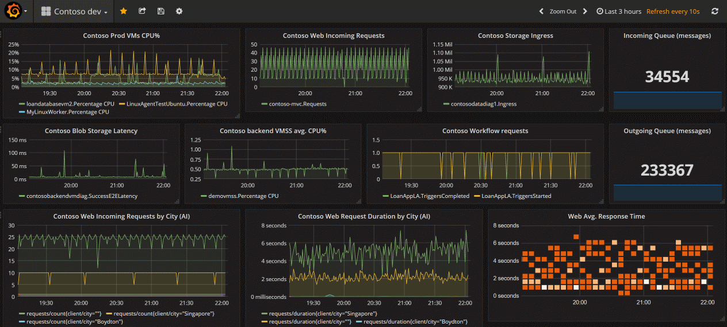
GRAFANA EXAMPLE
Notes:
One of the key points of adopting Grafana is how easy is to build a spot on dashboard. Basically you add one or several panels, each of one configured with one datasource, in our case always Prometheus as Datasource, and chose which kind of chart do you want and the query to obtain the data from the datasource. But we will see a bit more in a few minutes.

Slide 17

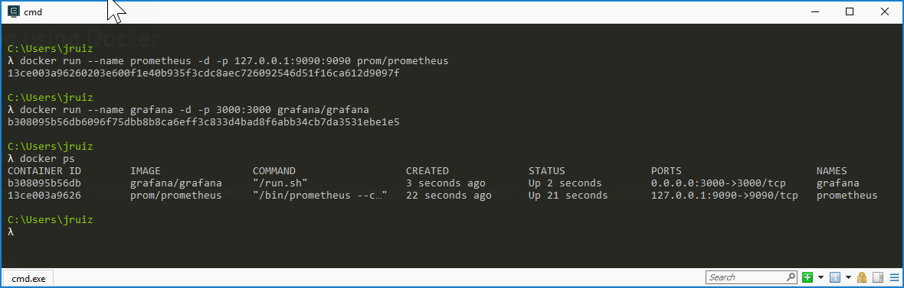
INSTALLING EVERYTHING WE NEED
Notes:
Now that the introductions have made and they are almost members of our family. Let’s see how we can install and configure every component. For that we are going use Docker. As we know we could first pull the image and the run the container or we can do both things at the same time. So in order to install Prometheus we should execute the following command: docker run --name prometheus -d -p 127.0.0.1:9090:9090 prom/Prometheus and we do the same iin order to install grafana: docker run -d -p 3000:3000 grafana/grafana

Slide 18

WAKE UP!
IS DEMO TIME!
Notes:
Show how to install the two containers Grafana and Prometheus.

Slide 19

WHAT SHOULD I MONITOR?
Notes:
Ok, we know that we have a system that can collect metrics. The next clever question to ask ourselves is what should I monitor? The short answers is you should monitor everything. Every library, subsystem and service should have at least a few metrics to give us some rough idea of what is going on. Now you can think OMG that could be a full time job if I have to write exporters for everything that we are using. Fortunately, there is a huge community and software vendors that are building exporters to be used or to be integrated with Prometheus. So you should only focus on building the metrics for your own software. Let’s see a list of this exporters, shall we?

Slide 20
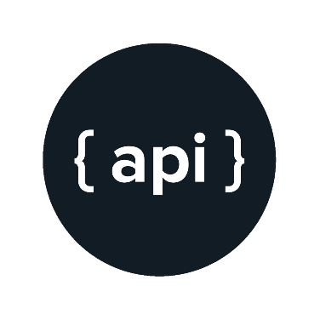
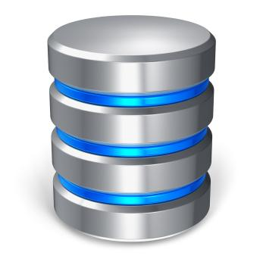
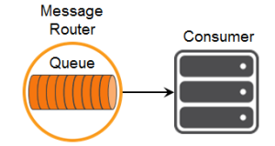
PROMETHEUS INTEGRATION
AWS ECS
ElasticSearch
EventStore
Github
MongoDB
Redis
AWS Health
MSSQL
RavenDB
Cloudflare
MySQL
PostgreSQL
Docker cloud
Docker hub
Oracle
NServiceBus
Kafka
RabbitMQ
Notes:
The Prometheus community is quite big and there are lots of third parties libraries that can help us exporting metrics. Some of them our maintain by the official Prometheus organization and some others by different organizations, user communities or individuals.
We can find exporters for databases, hardware, messaging systems, storage, http, APIs, logging and so on.
In addition, there are a lot of official and unofficial client libraries that allows us to create metrics for our applications. These libraries are available for the most common languages like: Go, Java, Python, Ruby, C++, .NET/C#, Node.js, PHP, Haskell, PHP, etc.
Let’s see how we can add instrumentation to our application.

Slide 21
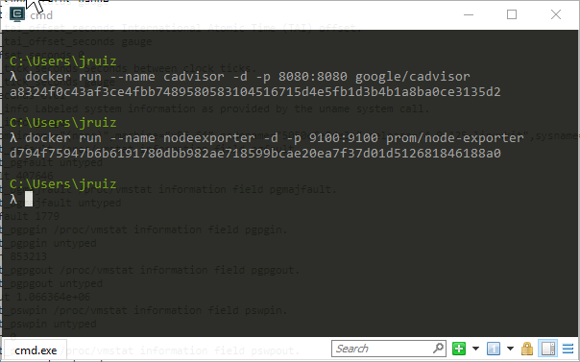

TWO EXPORTERS THAT WE WILL NEED
Notes:
There are two exporters that we should always consider when we work with Docker containers and Linux: Cadvisor and node exporter. In fact, the former we could use to monitor our containers even without using Prometheus, it provide us with an UI to visualise the health of our containers. On the other hand, node exporter, provide us with metrics for hardware and the Operating System, mandatory if we want to know space in disk, CPU usage, memory usage, network, etc. Let’s see them in action.

Slide 22
INSTRUMENTING OUR DOTNET CORE WEB API
Install-Package prometheus-net.AspNetCore
var counter = Metrics.CreateCounter("myCounter", "some help about this");
counter.Inc(5.5);
var gauge = Metrics.CreateGauge("gauge", "help text");
gauge.Inc(3.4);
gauge.Dec(2.1);
gauge.Set(5.3);
var summary = Metrics.CreateSummary("mySummary", "help text");
summary.Observe(5.3);
var hist = Metrics.CreateHistogram("my_histogram", "help text", new HistogramConfiguration {
Buckets = new[] { 0, 0.2, 0.4, 0.6, 0.8, 0.9 }
});
hist.Observe(0.4);
Notes:
The first thing we should do is adding the following nugget package prometheus-net.AspNetCore to our solution.
Ok now is time to add some instrumentation, the first thing we should now about Prometheus metrics is that there are four types of metrics that we can create:
Counter (counters go up and reset when the process restart, we can use the counter to register the number of exceptions for instance, or the number of requests
Gauge represents a value that can go up and down, we could use a Gauge that increase every time that we raise a domain event and decrease everytime that the domain event has been handled.
Summary: are observations over time, a great way to measure for instance, the duration of a request.
Histogram: track the size and number of events in buckets
All metrics can have labels, allowing grouping of related time series.
Finally, we want to expose this metrics to be read by Prometheus, we could create an endpoint in our application, /metrics so Prometheus can read it or use pushgateway.
This package provide us with a middleware plugin to expose our metrics via HTTP to be read by Prometheus. So we can call it from our startup.

Slide 23
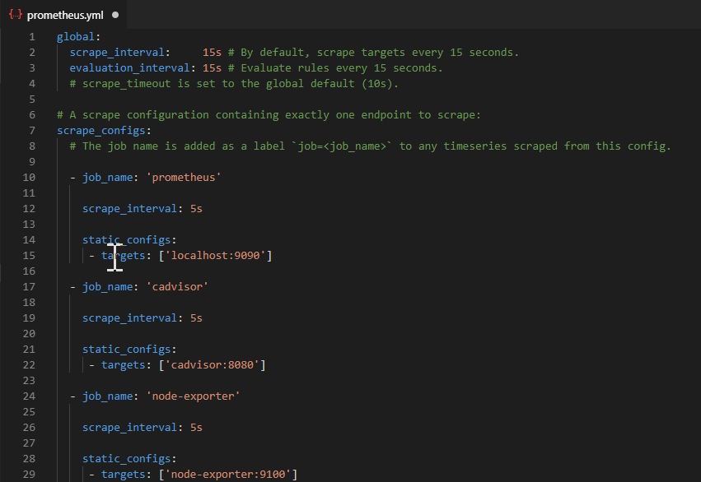
CONFIGURING PROMETHEUS
Notes:
We can configure Prometheus using a yml file. In this yml file we can specify things like how often we want to scrape information and the jobs or exporters for these metrics. Every exporter is define as a job, with a name and basically the endpoint to obtain the data. In our example we can see that we have define 3 jobs / exporters: Prometheus itself, cadvisor, that can give us information about the containers and node-exporter, that can give us information about the container’s host.

Slide 24
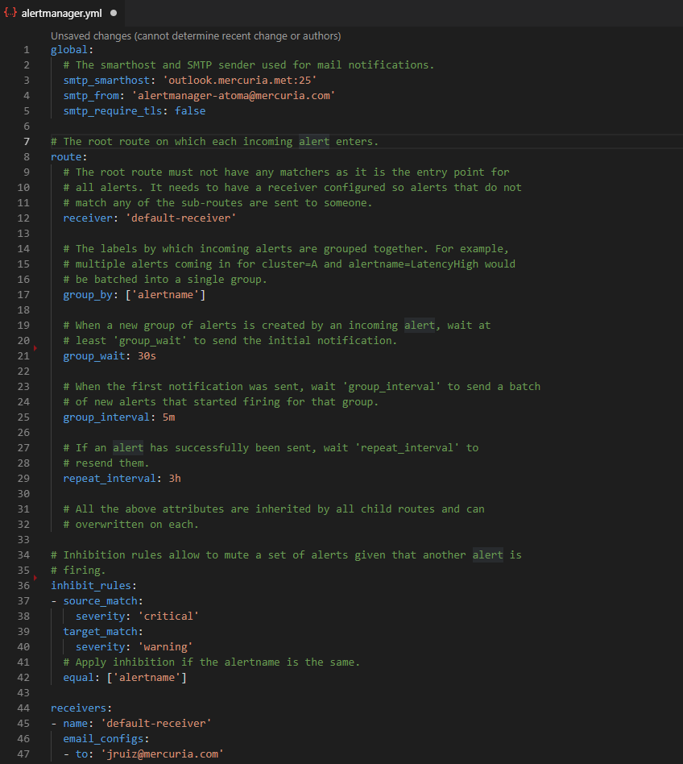
CONFIGURING ALERT MANAGER
Notes:
Ok, now we know how to expose some metrics from our web application: number of request, errors, events, etc. We know that there are some great exporters that give us information about the hardware and operating system where our application is hosted. In addition, we can use third parties exporters for our database system, messaging system, apis, etc.
Fine, but what happen is something goes wrong? Or we reach some thresholds where we should do somthing? Like for instance, the disk is getting full so we need to delete log files, or the CPU usage is always quite high or we need to scale up the memory, etc. We would like our monitoring system to alert us if any of the events described happen.
Welcome alert manager!
Alert manager is configure in the same way as Prometheus or Grafana, with a yml file. Yml are the new .ini or the new .xml files. We can configure the recipient for the alert: SMTP, slack, PagerDuty, so on. We can create some inhibit rules, to avoid send some alerts if something else is happening. We can group some alerts of simitar nature, etc.

Slide 25
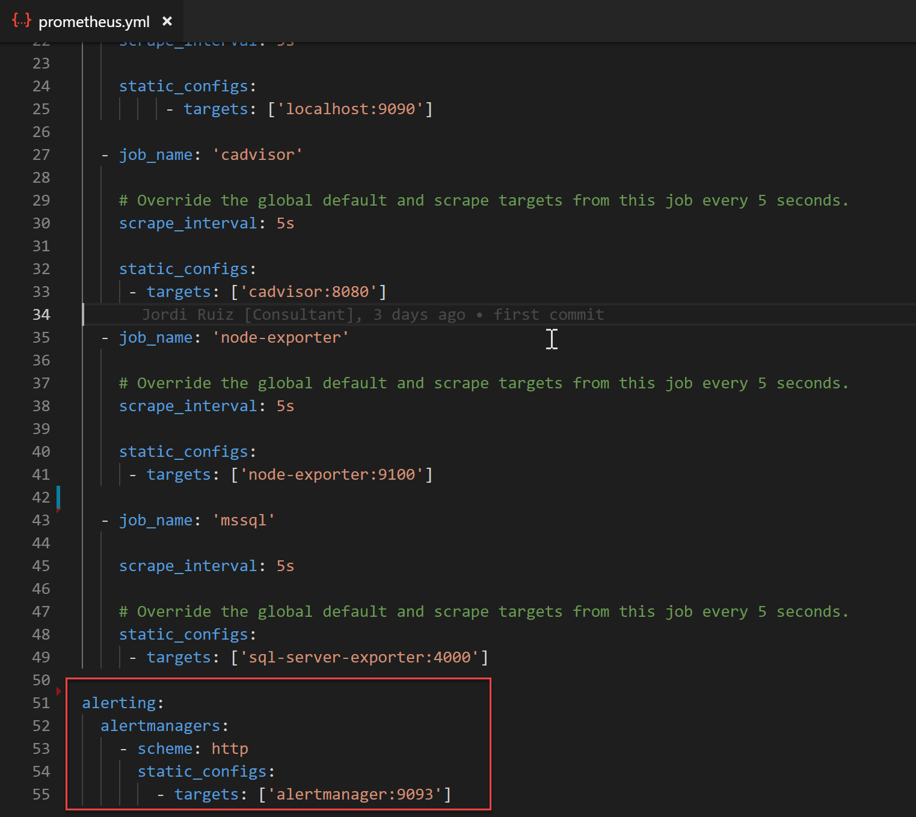
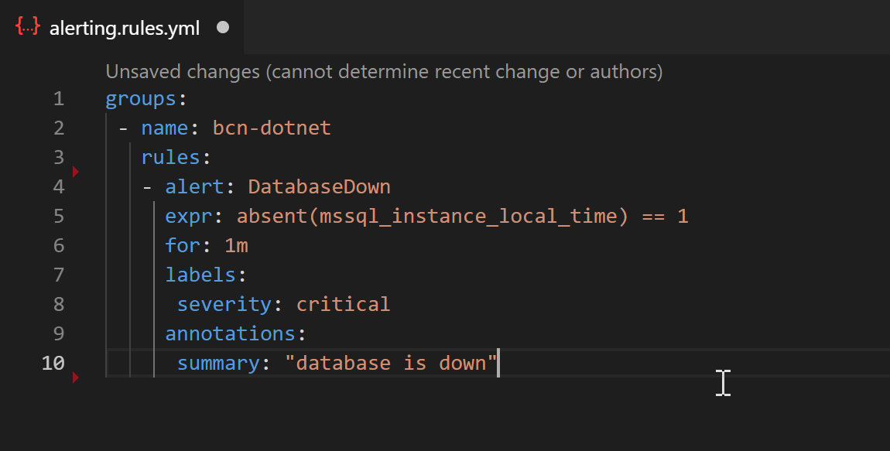
CONFIGURING PROMETHEUS TO USE ALERT MANAGER
Notes:
Ok, now we know how to expose some metrics from our web application: number of request, errors, events, etc. We know that there are some great exporters that give us information about the hardware and operating system where our application is hosted. In addition, we can use third parties exporters for our database system, messaging system, apis, etc.
Fine, but what happen is something goes wrong? Or we reach some thresholds where we should do somthing? Like for instance, the disk is getting full so we need to delete log files, or the CPU usage is always quite high or we need to scale up the memory, etc. We would like our monitoring system to alert us if any of the events described happen.
Welcome alert manager!
Alert manager is configure in the same way as Prometheus or Grafana, with a yml file. Yml are the new .ini or the new .xml files. We can configure the recipient for the alert: SMTP, slack, PagerDuty, so on. We can create some inhibit rules, to avoid send some alerts if something else is happening. We can group some alerts of simitar nature, etc.

Slide 26
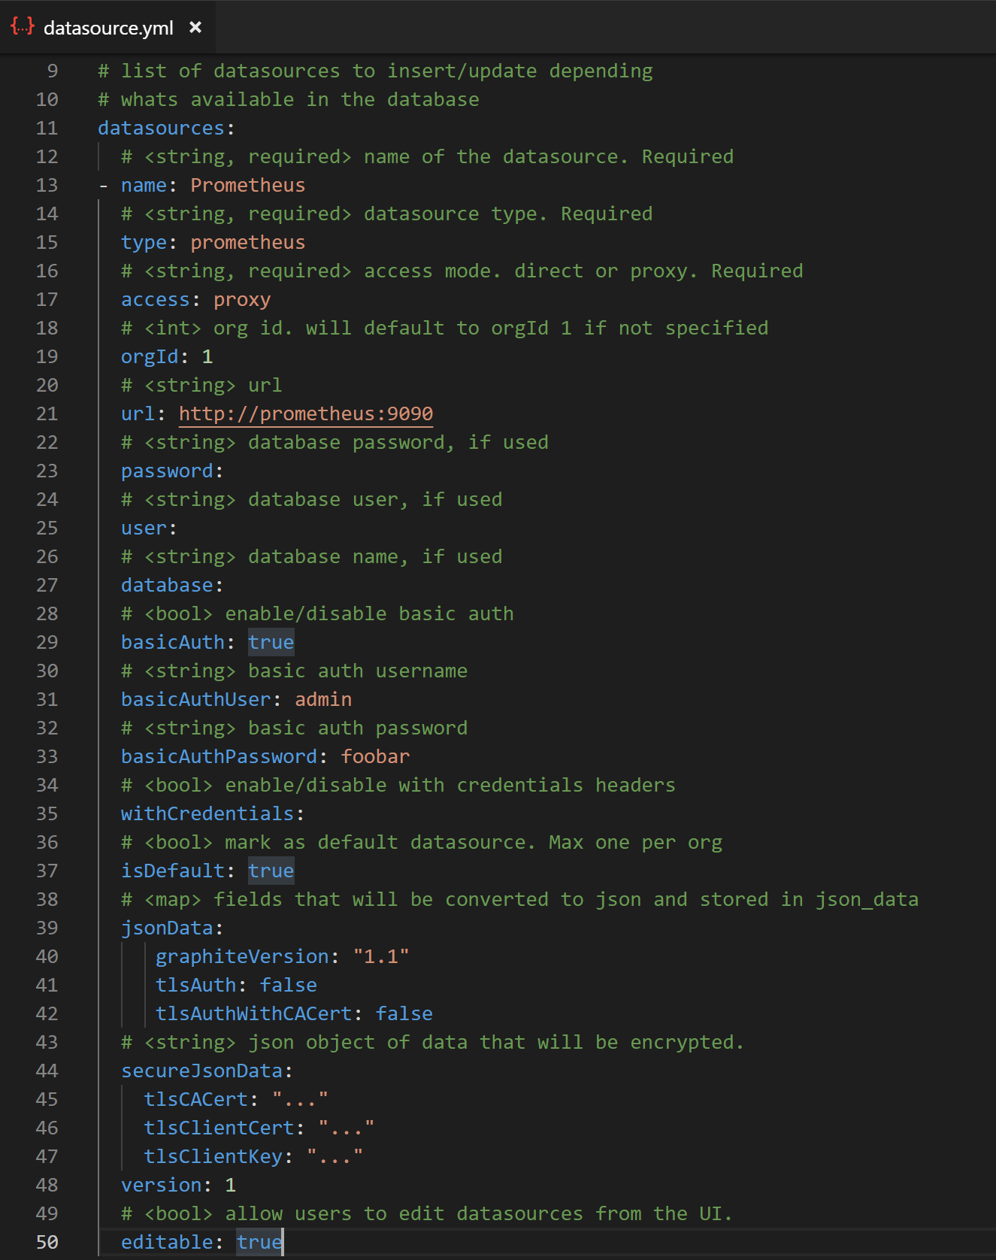
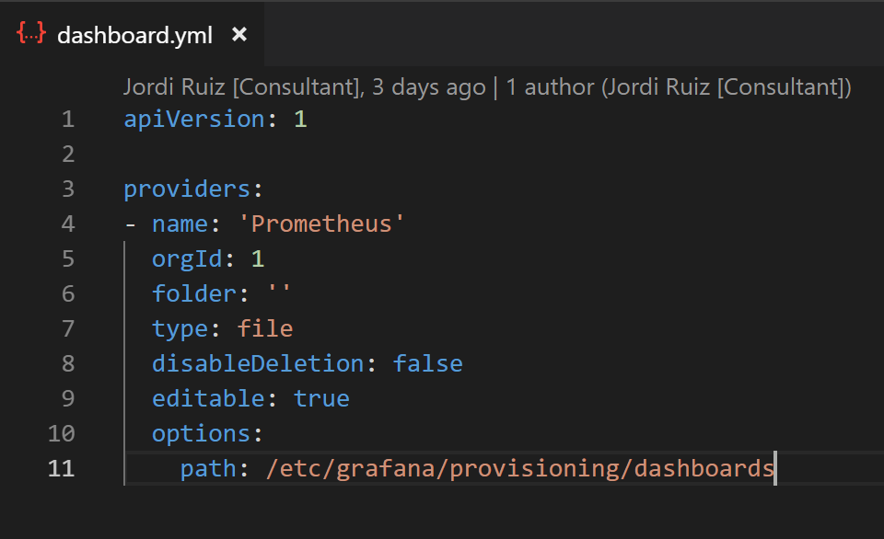
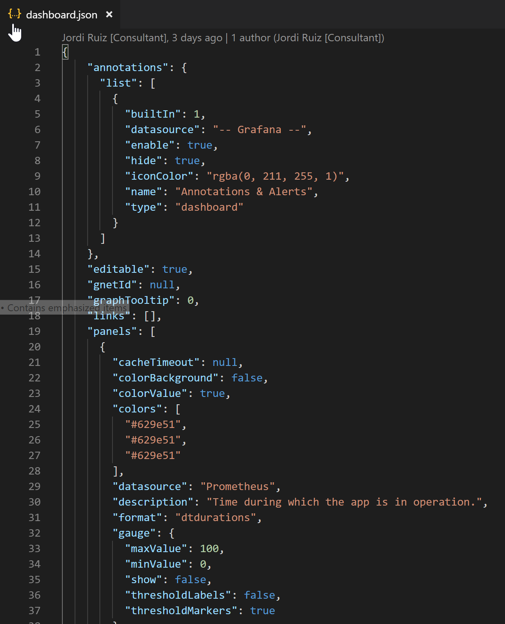
CONFIGURING GRAFANA
Notes:
Ok, now we know how to expose some metrics from our web application: number of request, errors, events, etc. We know that there are some great exporters that give us information about the hardware and operating system where our application is hosted. In addition, we can use third parties exporters for our database system, messaging system, apis, etc.
Fine, but what happen is something goes wrong? Or we reach some thresholds where we should do somthing? Like for instance, the disk is getting full so we need to delete log files, or the CPU usage is always quite high or we need to scale up the memory, etc. We would like our monitoring system to alert us if any of the events described happen.
Welcome alert manager!
Alert manager is configure in the same way as Prometheus or Grafana, with a yml file. Yml are the new .ini or the new .xml files. We can configure the recipient for the alert: SMTP, slack, PagerDuty, so on. We can create some inhibit rules, to avoid send some alerts if something else is happening. We can group some alerts of simitar nature, etc.

Slide 27
WAKE UP!
IS DEMO TIME!
Notes:
Show how to install the two containers Grafana and Prometheus.

Slide 28

Notes:
Ok, now we know how to expose some metrics from our web application: number of request, errors, events, etc. We know that there are some great exporters that give us information about the hardware and operating system where our application is hosted. In addition, we can use third parties exporters for our database system, messaging system, apis, etc.
Fine, but what happen is something goes wrong? Or we reach some thresholds where we should do somthing? Like for instance, the disk is getting full so we need to delete log files, or the CPU usage is always quite high or we need to scale up the memory, etc. We would like our monitoring system to alert us if any of the events described happen.
Welcome alert manager!
Alert manager is configure in the same way as Prometheus or Grafana, with a yml file. Yml are the new .ini or the new .xml files. We can configure the recipient for the alert: SMTP, slack, PagerDuty, so on. We can create some inhibit rules, to avoid send some alerts if something else is happening. We can group some alerts of simitar nature, etc.

Slide 29


Slide 30


Slide 31


